Slide 1

ANDROID 6.0 MARSHMALLOW
WHAT YOU NEED TO KNOW
Michael Fazio
Senior Software Engineer
Skyline Technologies
@Faziodev

Slide 2

Principal Sponsor
Thank our Principal Sponsor by tweeting and following @SkylineTweets
http://www.SkylineTechnologies.com

Slide 3








Sponsors
GOLD
SILVER

Slide 4


August 8th – 10th 2016
Kalahari Resort, Wisconsin Dells
http://www.ThatConference.com

Slide 5
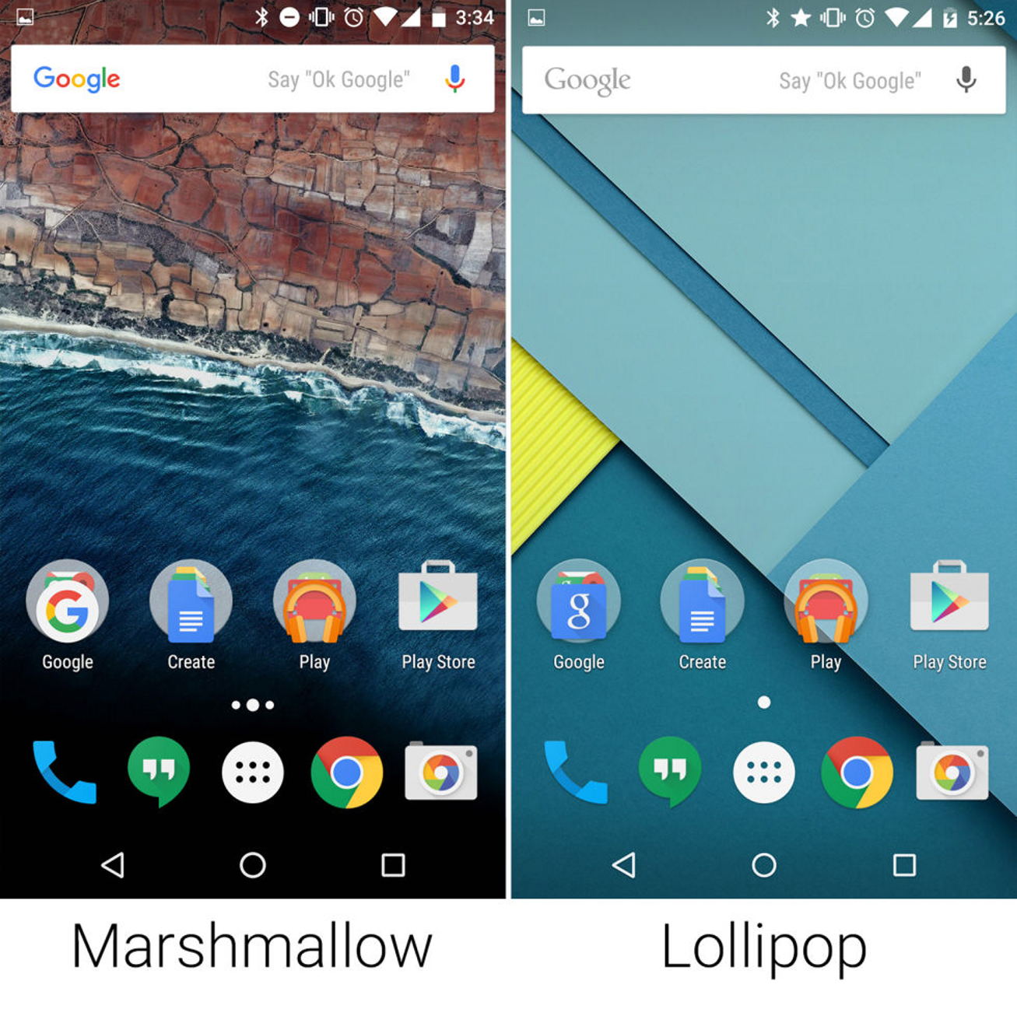
Marshmallow vs. Lollipop
Notes:
Remember, the updated Google search bar is actually app-related, not OS-related.

Slide 6
Overview
Permissions
Doze/App Standby
Adoptable Storage Devices
Google Now on Tap
Auto-Backup
App Linking
Direct Share
Chrome Custom Tabs
Native API/Feature Support
OS Enhancements
Development Considerations

Slide 7
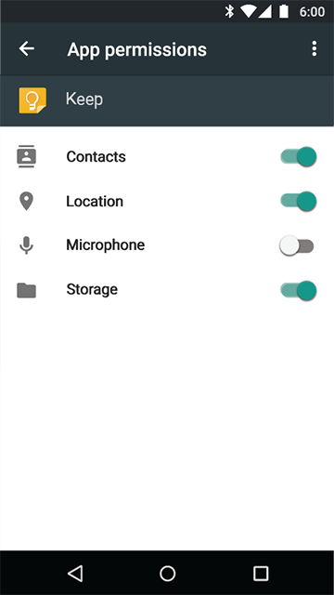
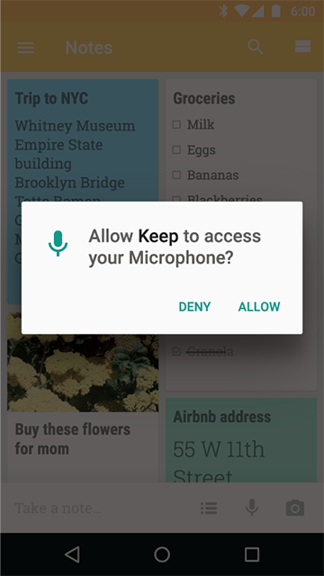
Permissions

Slide 8
Permissions
Run-Time or On-Demand
No install-time permissions
Some permissions are in other areas of settings
Old apps will still work
All apps can access the Internet
Notes:
Permissions can either be shown at run-time or on-demand (via pop-up)
Apps targeting v23 will not ask for permissions acceptance right away
Critical permissions at run-time (as soon as the app's started)
"Extra" permissions on-demand
Allow is permanent, deny is one-time
Pop-up shows a "Never Ask Again" checkbox
Can still turn off via settings menu
Denied permissions shouldn't crash apps
App is informed so it can react
Permissions cannot be turned off while an app is using the permission
Background processing is killed
Old apps are not blocked permissions, but given fake/empty data
Warning is shown
Permissions are unique to each user
All apps will have internet access
Note permissions in other areas
Accessibility
Device Administrators
Do Not Disturb Access
Draw Over Other Apps
Modify System Settings
Notification Access
Tap and Pay
Usage Access

Slide 9

Doze and App Standby

Slide 10
Doze + App Standby
Unplugged + Stationary + Screen Off + Time
Maintenance Windows
Affects all apps, even if they don’t target Marshmallow
Able to partially whitelist apps
App Standby == App not being actively used by the user
Basically puts an app to sleep
Notes:
Turns off network access, syncs, alarms
Maintenance Window is a short period of time where apps run like normal again
Maintenance Windows become less and less frequent over time
Doze is disabled by moving/turning on/connecting the device
Affects all apps running on Android 6.0, regardless of target API
Restrictions
Network access suspended
Wake locks ignored
AlarmManager deferred to next window (but can be manually overridden with code)
setAndAllowWhileIdle() and setExactAndAllowWhileIdle()
Cannot be fired more than once every 15 minutes
No Wi-Fi scans
Job scheduler is disabled
Sync adapters are disabled
Whitelisted apps can use the network and partial wake locks
Partial wake locks causes CPU to continue to run, but screen/keyboard stay off
Whitelisting can be manually set or apps can take users to battery optimization screen or directly to whitelist settings
App Standby
Time + following actions
User explicitly launches the app
App has a foreground process
App generates a notification on lock screen/notification tray
Disabled when a user plugs in the device
Long idle time => Network access for idle apps once a day

Slide 11
GCM While Dozing
GCM = Google Cloud Messaging
Single, persistent cloud connection
Notes:
All apps needing real-time connectivity can use GCM
Shared connection == optimized battery usage
High-priority GCM messages allows waking from idle, but then returns to Doze state
Does not otherwise affect Doze mode

Slide 12
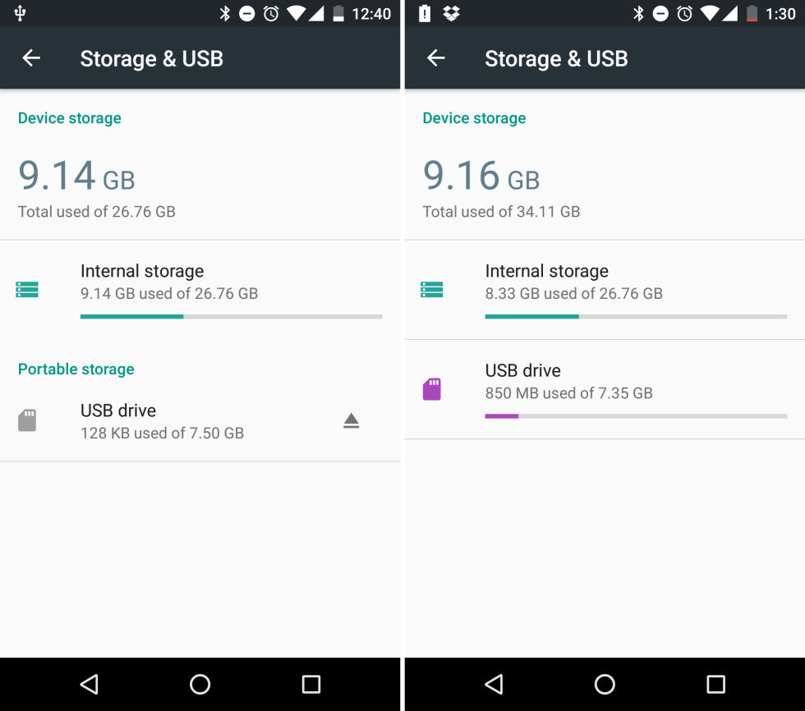
Adoptable Storage Devices
Notes:
Previously, moving to the SD was manual
Some apps could be moved over
Some apps supported storing data on the SD card
External storage (SD card) can be recognized as internal storage
Device is encrypted and formatted same as internal storage
Storage speed is quickly tested to see how well it'll work
Dynamically referenced paths (getFilesDir(), getCacheDir(), etc) will work with SD card "internal" storage

Slide 13
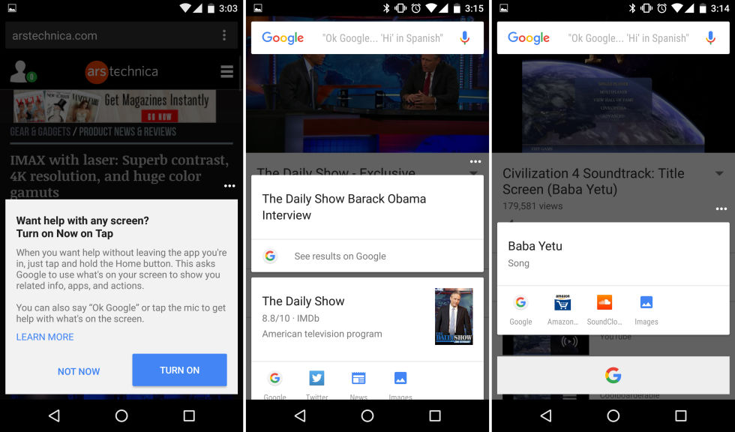
Google Now on Tap
Notes:
Press/Hold Home button on a page
Uses what's on screen for a web search
Click on title or bottom G -> Google Now
Other links available
Uses Assist API
Allows custom APIs for Now on Tap

Slide 14
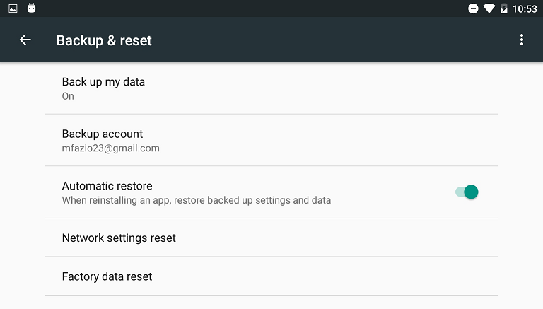
Auto-Backup
Notes:
Backs up everything in /data/data/[app-name]
Devs and users can completely opt-out
Automatically available if device is idle, charging, on WiFi, and >24 hours since last backup
Stored encrypted on user's Google Drive, does not count against user's drive quota
No additional code needed
Defaults to backing up almost all data an app creates, excluding automatically excluded data files
Backup XML can be created
Include/Exclude files/domains (file, database, sharedpref, external, root) explicitly
Specifying an include element will cause the system to only include those items
Excludes take precedence
Can globally disable via android:allowBackup="false"
Lower versions of Android can either
Implement the Backup API - https://developer.android.com/training/backup/backupapi.html
Use existing backup mechanism via BackupAgent

Slide 15
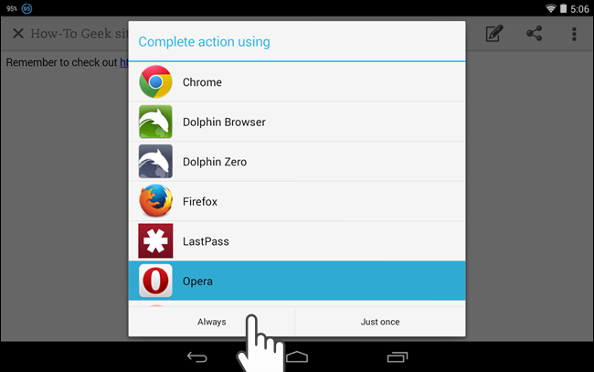
App Linking
Notes:
Lollipop would open chooser with all apps with a corresponding intent filter

Slide 16
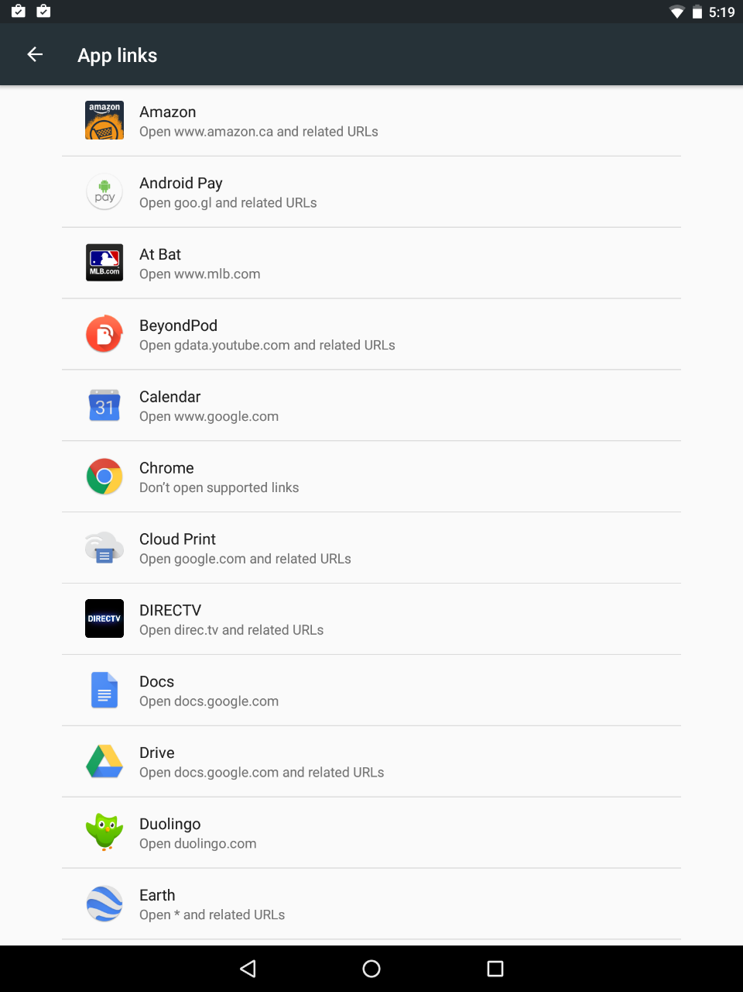
App Linking
Notes:
Allows the owner of a website to link the site to their own app instead of having a ton of options
Automatically opens up official app
User can turn this off in Settings > Apps > [App Name] > Open by Default

Slide 17
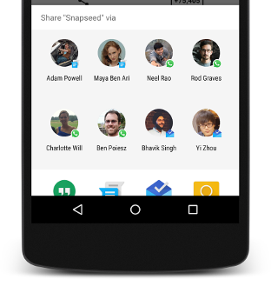
Direct Share
Notes:
Top part of the share menu will be apps with direct share ability
Added apps are configurable within app XML
Shows recent contacts in the apps

Slide 18
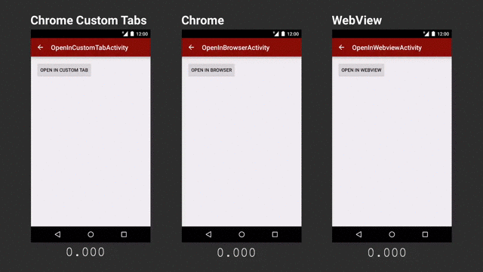
Chrome Custom Tabs
Notes:
Part of Chrome v45, not Marshmallow
Devs currently build in-app browsers via WebViews
Custom, skinnable Chrome tab
Customize toolbar color
Enter/Exit animations
Custom actions to toolbar/overflow menu
App stays attached
Foreground importance (won’t be automatically closed)
Back arrow drops user back into app
Back button moves back, or back to app from first page
Has Chrome features
Auto-complete
Cookies
Cache
Browser/data can be pre-loaded via configuration

Slide 19
Native API/Feature Support
Fingerprint Reader
Confirm Credentials
Android Pay
USB Type-C
Native 4K Display
Bluetooth Stylus
Flashlight API
Notes:
Fingerprint Reader
Devs have full control over UI
Integrate into custom apps
Confirm Credentials
Allows for re-authentication via lock screen
Apps can call an intent to re-auth user
Allows for a timeout window to be set
4K Display
Physical resolution can be queried
Bluetooth Stylus
Allows for pressure and button info
Flashlight API
Built-into UI
Flashlight turns off when opening the camera

Slide 20
OS Enhancements
Vertical App Drawer
Volume and Notifications
Smarter Text Selection
APK Validation
Status Bar Tweaking
Notes:
Smarter text selection also allows quick translation
Volume settings have been simplified
Runtime
App-level peek and priority settings
Peek is the top screen area that shows up for messages
Do Not Disturb page
Status bar tweaking
Turn off icons
Re-arrange items

Slide 21
Development Notes
Apache HTTP Client support is removed
Programmatic access to local hardware IDs removed
OpenSSL -> BoringSSL
Floating toolbar for text selection available
Full List - https://developer.android.com/about/versions/marshmallow/android-6.0-changes.html
Notes:
Marshmallow removes programmatic access to the device’s local hardware identifier for apps using the Wi-Fi and Bluetooth APIs
BoringSSL is only relevant for NDK
Fork of OpenSSL
Text selection toolbar requires a few code changes, found on the full list page.

Slide 22
Additional Links
Android 6.0 APIs - https://developer.android.com/about/versions/marshmallow/android-6.0.html
Android 6.0 Changes - https://developer.android.com/about/versions/marshmallow/android-6.0-changes.html
Auto Sync API - https://developer.android.com/training/backup/autosyncapi.html
Adoptable Storage - http://developer.android.com/about/versions/marshmallow/android-6.0.html#adoptable-storage
App Linking - https://developer.android.com/training/app-links/index.html
Doze - http://developer.android.com/training/monitoring-device-state/doze-standby.html
Android 6.0 Examples - https://developer.android.com/about/versions/marshmallow/samples.html

Slide 23

THANK YOU!
Twitter - @faziodev
GitHub - https://github.com/mfazio23
LinkedIn – https://www.linkedin.com/in/mfazio23
Presentations - https://github.com/MFazio23/Presentations

